Slide 1
Online Gaming Anxiety by Esraa Zaher
Gaming and its association with anxiety, life satisfaction and social phobia

Slide 2
About the data
This dataset consists of data collected as a part of a survey among gamers worldwide. The questionnaire asked questions that psychologists generally ask people who are prone to anxiety, social phobia, and less to no life satisfaction

Slide 3

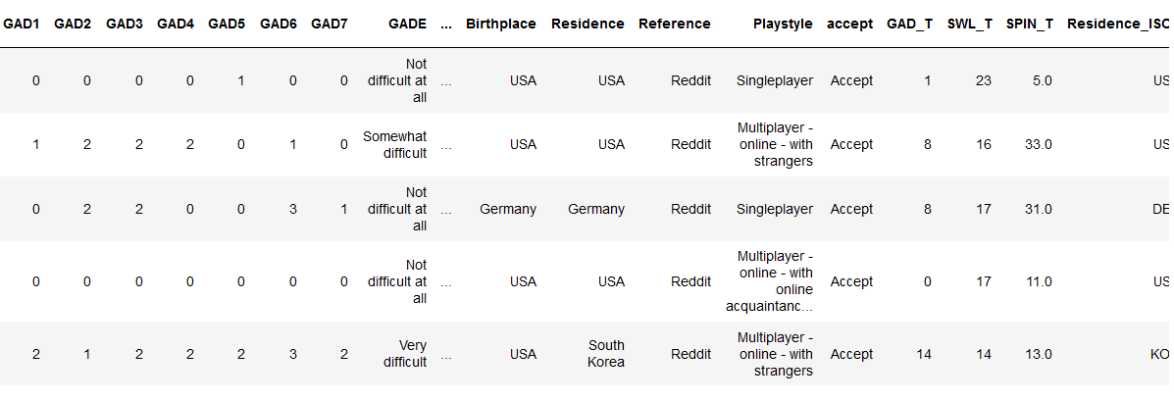
ABOUT DATA
DATA FROM KAGGLE
55
COLUMNS
13463
TO GET THIS DATA , FOLLOW THE LINK
https://www.kaggle.com/datasets/divyansh22/online-gaming-anxiety-data
ROWS

Slide 4

Our Strengths
GAD
SWL
SPIN
GENERAL ANIXIETY DISORDER
SATISFACTION WITH LIFE SCALE
SOCIAL PHOBIA INVENTORY

Slide 5

GAD
01

Slide 6
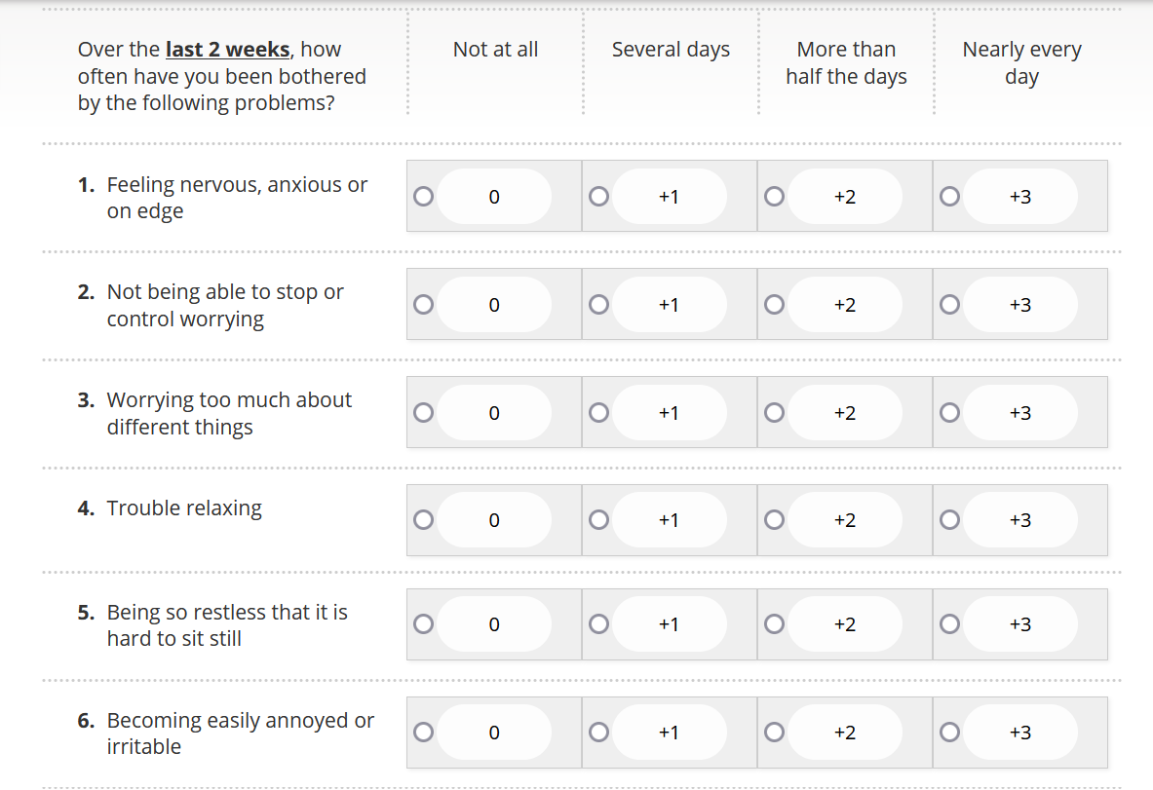
When screening for anxiety disorders, a score of 8 or greater represents a reasonable cut-point for identifying probable cases of generalized anxiety disorder;
further diagnostic assessment is warranted to determine the presence and type of anxiety disorder. Using a cut-off of 8 the GAD-7 has a sensitivity of 92% and specificity of 76% for diagnosis generalized anxiety disorder.
The following cut-offs correlate with level of anxiety severity:
Score 0-4: Minimal Anxiety
Score 5-9: Mild Anxiety
Score 10-14: Moderate Anxiety
Score greater than 15: Severe Anxiety
GAD QUESTIONS

Slide 7
02
SWL

Slide 8

Satisfaction with Life Scale (SWLS)
The SWLS is a short 5-item instrument designed to measure global cognitive judgments of satisfaction with one’s life. The scale usually requires only about one minute of a respondent’s time, where respondents answer on a Likert scale. The questions are open to interpretation, making this scale suitable for adults with a range of background. It most appropriate for use in non-clinical populations.
Scoring and Interpretation:
Scores consist of a raw score (between 5 and 35). Higher scores represent higher life satisfaction. Scorers can be assigned into six well-being categories and interpretative text in provided for each.
30- 35 Extremely satisfied
25 – 29 Satisfied
20 – 24 Slightly satisfied
15 – 19 Slightly dissatisfied
10 – 14 Dissatisfied
5 – 9 Extremely dissatisfied

Slide 9
03
SPIN

Slide 10

What is social anxiety?
Social anxiety is more than feeling nervous or shy in groups. Social anxiety is the intense and often overwhelming fear of social situations, especially those with the potential to be criticized or excluded. This includes fears of performing tasks in front of others (writing, speaking, eating, dancing, sweating)
The scale is as follows:
Not at all
A little bit
Somewhat
Very much
Extremely
SPIN test scoring is based on assigning number values or weights to each scale category and then adding the numbers to see where your symptoms land on the scale. Many online versions of the SPIN test will do the tallying part and reveal your score.
It’s said that a score of 19 or more on the SPIN is suggestive of social phobia or social anxiety disorder.

Slide 11

Explanation of Data
And the relationship of columns to GAD, SWL AND SPIN

Slide 12
Some column
whyplay
Game
Platform
Reason to play the game.
Name of the game they play.
Mode of game playing (PC, Console, Mobile etc.)
Hours
earnings
streams
Number of hours in a week devoted to playing.
Earnings from the game (if any)
Number of online streaming of the game.

Slide 13
challanges
Step 1
Step 3
Handling some column to extract fewer number of unique values
Discripe the null values and deal with each column sepratly
Step 5
Create a Dashboard with streamlet
Step 2
Step 4
Drop not useful columns
Make visuales and ask all qustions we need

Slide 14

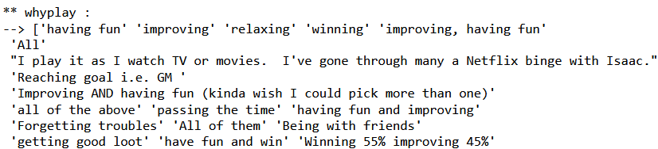


01
02
UNIQUE VALUES
03
About WHYPLAY:
THE COLUMN HAS 406 UNIQUE VALEUS
DEFINE IMP. U.VALUES:
LIKE HAVINGFUN , IMPROVING …
THE SOLUTION
GROUP ANOTHER UNIQUE VALUES IN the right row

Slide 15
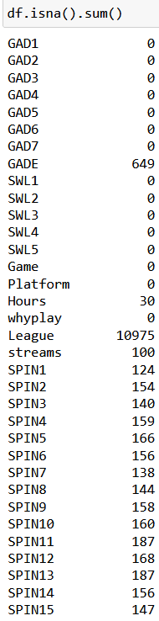
01
NULL VALUES
02
03
Fill null with mode:
In numerical columns like SPINS and streams
Full null with undefined :
In league column
Drop null values:
From column like work and hours

Slide 16
Promotion
HOURS COLUMN
Number of hours in a week devoted to playing so must don't be more than 168 if the player sleep just 4 hours per day so it will be 164 hours after checking outliars droped all Hours over 100
PLAY STYLE COLUMN
Make all rows After index 5 to category other
Age column
After checking outliars I droped all Ages over 50

Slide 17
02
preparation for machine learning
03
01
Split data to train and test
Feature scaling and modeling
Convart the catigorical data to numeric data by labolEncoder

Slide 18


THANKS
ENG. AbdElrhman
Epsilon Al
DATA SCIENCE INSTRUCTOR
Computer Training School

